Slide 1
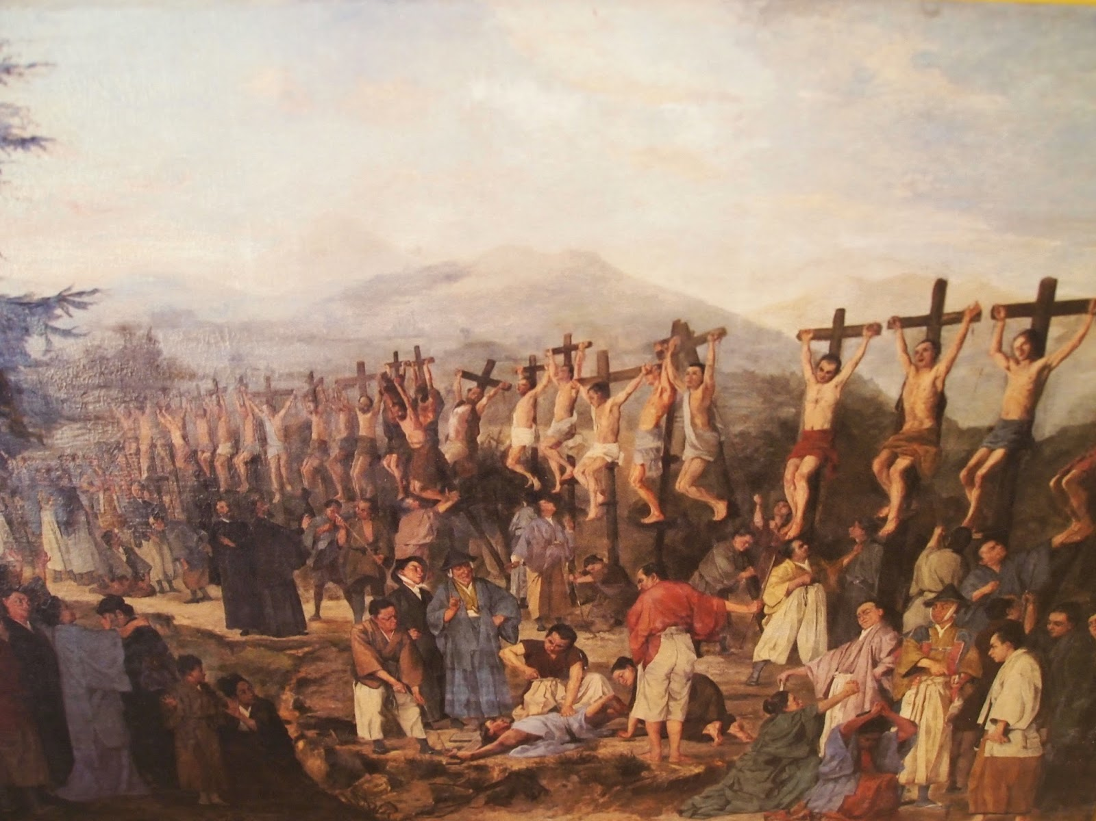
日本のキリスト教殉教者 Japan Christian Martyrs
Patrick Zukeran
Evidence and Answers
evidenceandanswers.org

Slide 2
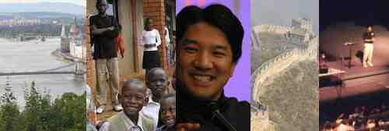
Evidence and Answers Radio evidenceandanswers.org
Evidenceandanswers.org
Over 100 interviews with top Christian scholars
Debates
Seminars and messages
Articles
Resources
KGU 99.5 FM Hawaii (9:30 AM Mon-Fri, Fri 4:30 PM)
KLHT Hawaii 1040 AM (Sat. 12:30 PM) DZAS Manila (Sat 7 PM & Sun 8 PM)

Slide 3
福音の日本への到来 Gospel Arrives in Japan 1549 A.D.
あなたがたは、『刈り入れ時が来るまでに、まだ四か月ある。』と言ってはいませんか。さあ、わたしの言うことを聞きなさい。目を上げて畑を見なさい。色づいて、刈り入れるばかりになっています。
Look, I tell you, lift up your eyes, and see that the fields are white for harvest. - ヨハネ 4:35

Slide 4
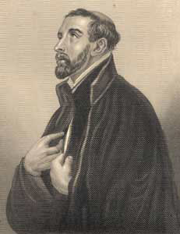
Arrival of Western Christianity 西方キリスト教の到来
フランシスコ・ザビエルFrancis Xavier arrived in 1549
He was born in Spain in 1506.
He established churches in India, Southeast Asia and Japan

Slide 5
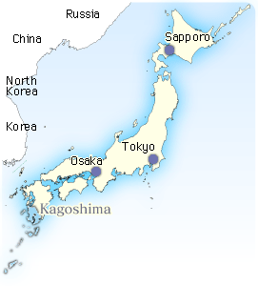
福音の日本への到来 Gospel Arrives in Japan
Xavier landed in Kagoshima and traveled to Yamaguchi.
He met with the Daimyo of Yamaguchi who granted him a license to preach and use of an abandoned temple

Slide 6
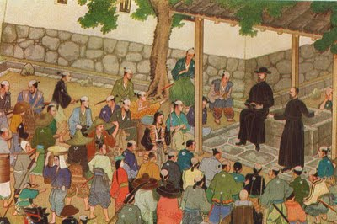
日本人の葛藤 Struggles of the Japanese
Why is there evil?
Why did God create hell?
Why can’t people escape hell?
Why should our ancestors go to hell if they never heard the gospel?

Slide 7
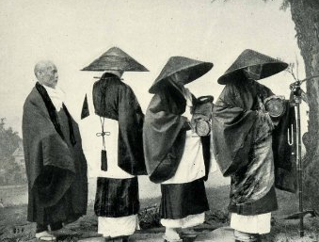
仏教に対するザビエルの見解 Xavier on Buddhism
“On certain days the bonzes preach publicly. The sum of all their discourses is that none of the people will be condemned to hell, whatever may be the number of their past and present crimes, for the founders of their sects will take them out of the midst of those flames, if perchance they are condemned to them, especially if the bonzes who have made satisfaction for them constitute themselves their intercessors.”

Slide 8
Xavier on Buddhism
“And they say women are as badly off if they neglect the five precepts. For they say that each woman, on account of her monthly courses, is covered with more sins than all men put together, and that thus so foul a creature can hardly be saved. They go on to say that there is some hope even for women of escaping from the prison of hell, if they give a great deal more than the men to the bonzes.”

Slide 9
Xavier on Buddhism
“They further declare that persons who in their lifetime have given money to the bonzes will after their death receive ten times as much in the same coin, for the necessities of their new life; and there are numbers of men and women who entrust considerable sums to the bonzes, in order to receive tenfold in the next world, and the bonzes give them a security in notes, which they write.

Slide 10
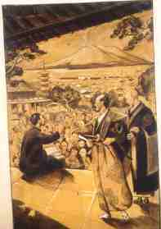
Xavier on Buddhism
One thing is very amusing, that though they take money from everybody by way of alms, they themselves never give anything to any one. I omit, for the sake of brevity, the infinite number of ways they have of getting money given to them. But I cannot help grieving and feeling indignant at all the tribute the people pay to men like these, and all the honour in which they hold them....

Slide 11
Xavier on Buddhism
The Japanese doctrines teach absolutely nothing concerning the creation of the world, of the sun, the moon, the stars, the heavens, the earth, sea, and the rest, and do not believe that they have any origin but themselves.

Slide 12
Xavier on Buddhism
The people were greatly astonished on hearing it said that there is one sole Author and common Father of souls, by whom they were created. This astonishment was caused by the fact that in their religious traditions there is nowhere any mention of a Creator of the universe.

Slide 13
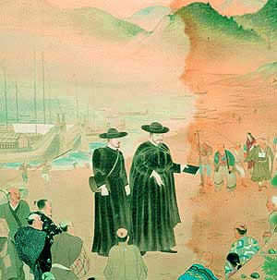
キリスト教の日本における成長 Christianity Grows in Japan
In two years, a thousand Japanese embraced Christianity.
Xavier was so impressed with Japan he called for only the missionaries of highest quality to be sent.

Slide 14
Francis Xavier
Japan is the only country yet discovered in these regions where there is hope of Christianity permanently taking root.
“These are the best people so far discovered and it seems to me that among the unbelievers no people can be found to excel them.”

Slide 15
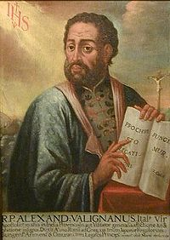
教父アレッサンドロ・ヴァリニャーノ Father Alexander Valignano
“Of all the nations I have ever visited Japan is the most appropriate nation to receive salvation.”

Slide 16
日本における福音 Gospel in Japan
By 1597 it is estimated that there were nearly 300,000 Christians in Japan.
Father Organto wrote that Japan would be Christianized in 30 years.
By the end of the 16th century, hundreds of churches were established throughout Japan and many Daimyos were baptized as Christians.

Slide 17
キリスト者の迫害 Christian Persecution
義のために迫害されている者は幸いです。天の御国はその人のものだからです。 Blessed are those who are persecuted for righteousness’ sake, for theirs is the kingdom of heaven. - マタイ 5:10

Slide 18
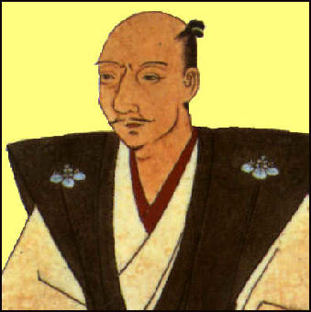
織田信長 Oda Nobunaga ( 1534-1582 A.D.)
Became the most powerful lord who nearly united Japan
Christianity flourished under Nobunaga
He despised the Buddhist priests
He allowed Christians to preach throughout Japan
He even had discussions with the priests

Slide 19
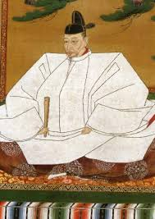
Toyotomi Hideyoshi (1537-1598 )
Avenged his lord and united Japan in 1584
By 1587 he viewed Christianity as a threat to his power and outlawed Christianity

Slide 20
豊臣秀吉 Toyotomi Hideyoshi (1537-1598 )
3 Factors prompted his persecution
A Christian Daimyo, Takayama Ukon

Slide 21
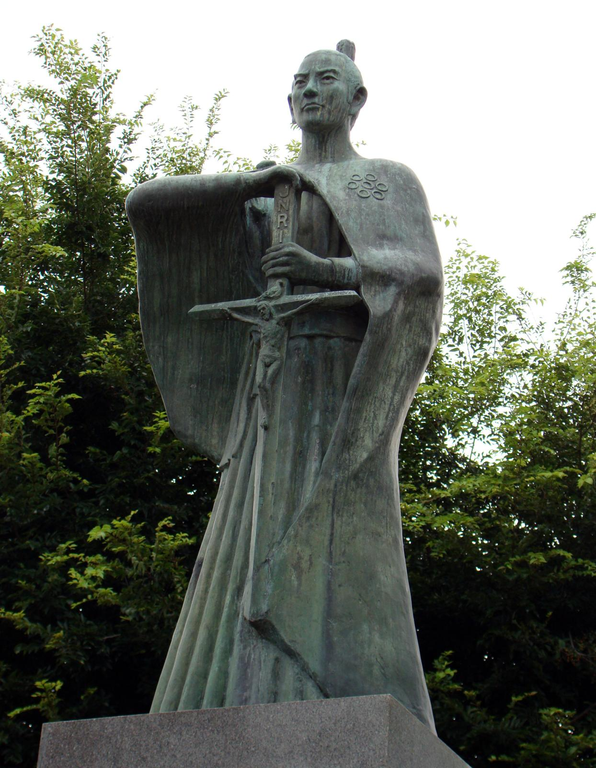
高山右近 Takayama Ukon
He closed down Buddhist Temples and Shinto Shrines.
In 8 years 18,000 of his 25,000 citizens were baptized.
Hideyoshi ordered him to give up his faith in Christ.
Takayama refused and was stripped of his title and his lands.

Slide 22
豊臣秀吉Toyotomi Hideyoshi
3 Factors prompted his persecution
迫害を推し進めた三つの要素
A Christian Daimyo, Takayama Ukon
The lucrative trade of Nagasaki
1596 a Spanish galleon wrecked in the Bay of Urago

Slide 23
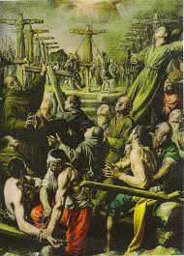
26 Nagasaki Martyrs 1597
First Christian martyrs of Japan
Rounded up in Kyoto, their left ears were cut off, and were marched 600 miles to Nagasaki
In Nagasaki they were chained to crosses and then stabbed with spears

Slide 24
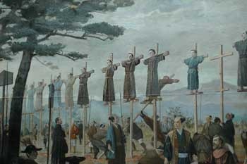
長崎26聖人 26 Nagasaki Martyrs

Slide 25
長崎殉教者記念館 Nagasaki Martyrs Museum

Slide 26
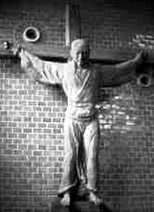
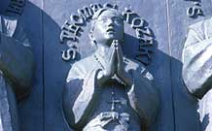
Nagasaki Martyrs
トマス小崎
Thomas Kozaki
パウロ三木Paul Miki

Slide 27
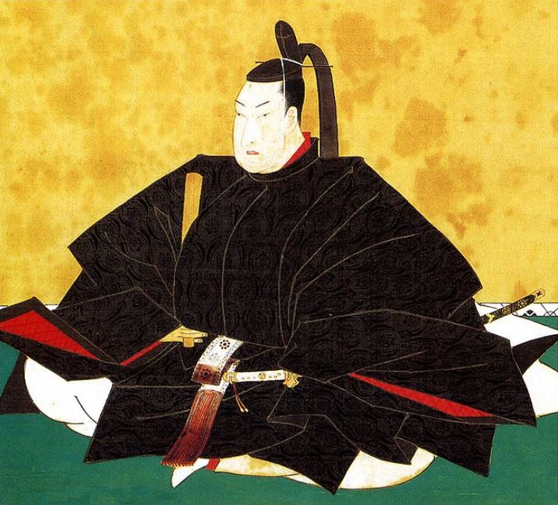
徳川将軍 Tokugawa Shogun (1600-1868 )
Hideyoshi died in 1598
In 1610 Ieyasu家康 (1543 - 1616) Tokugawa expelled all foreign missionaries from Japan
In 1614 Ieyasu outlawed Christian activity in Japan
The Shogun sent his men throughout the land to interrogate every citizen

Slide 28
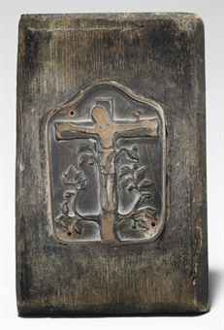
Tokugawa Shogun (1600 - 1868 )
Plaques with the picture of Jesus or Mary (Fumie踏み絵) were used.
The Shogun realized the most effective weapon was apostasy, “Korobi Kristian転びキリシタン”
The best way to force one to renounce their faith was torture

Slide 29
Tokugawa Shogun (1600 - 1868)
The BBC News states that the “… the campaign against Christianity which took place in Japan in the early 1600s was more ferocious than any other religious persecution in the history of the Church.”
Duncan Bartlett, “Japan looks back on 17th-Century persecutions,” BBC News, 24 Nov. 2008, http://news.bbc.co.uk/2/hi/7745455.stm.

Slide 30
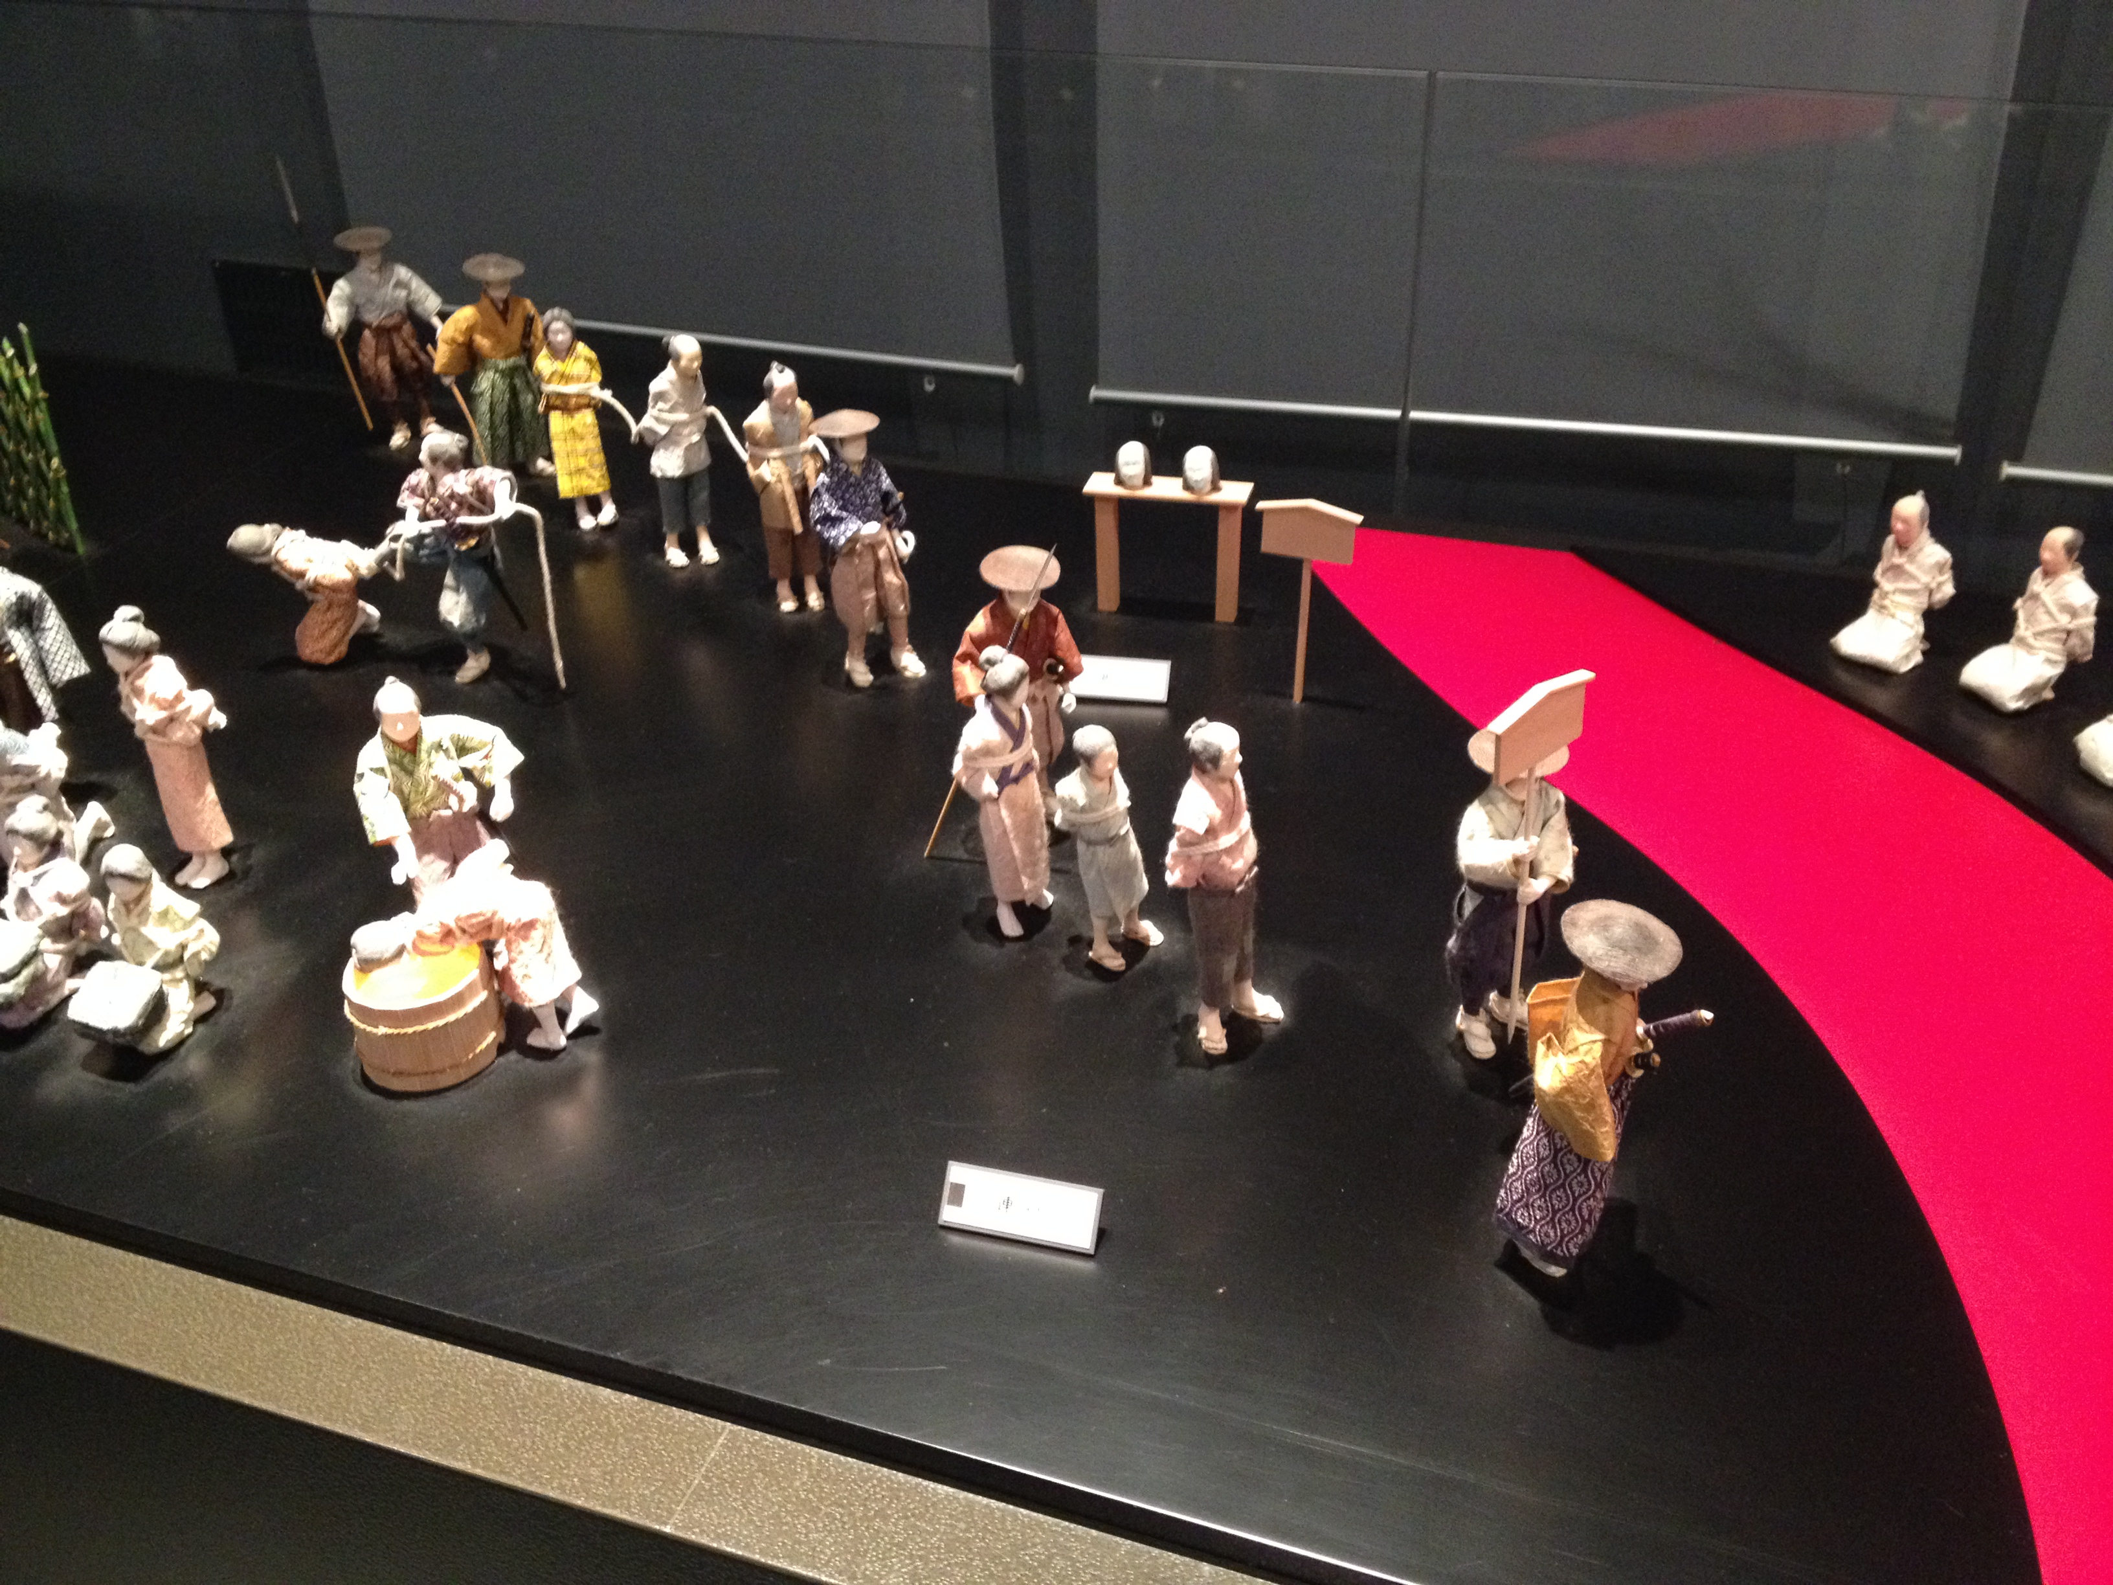

Slide 31
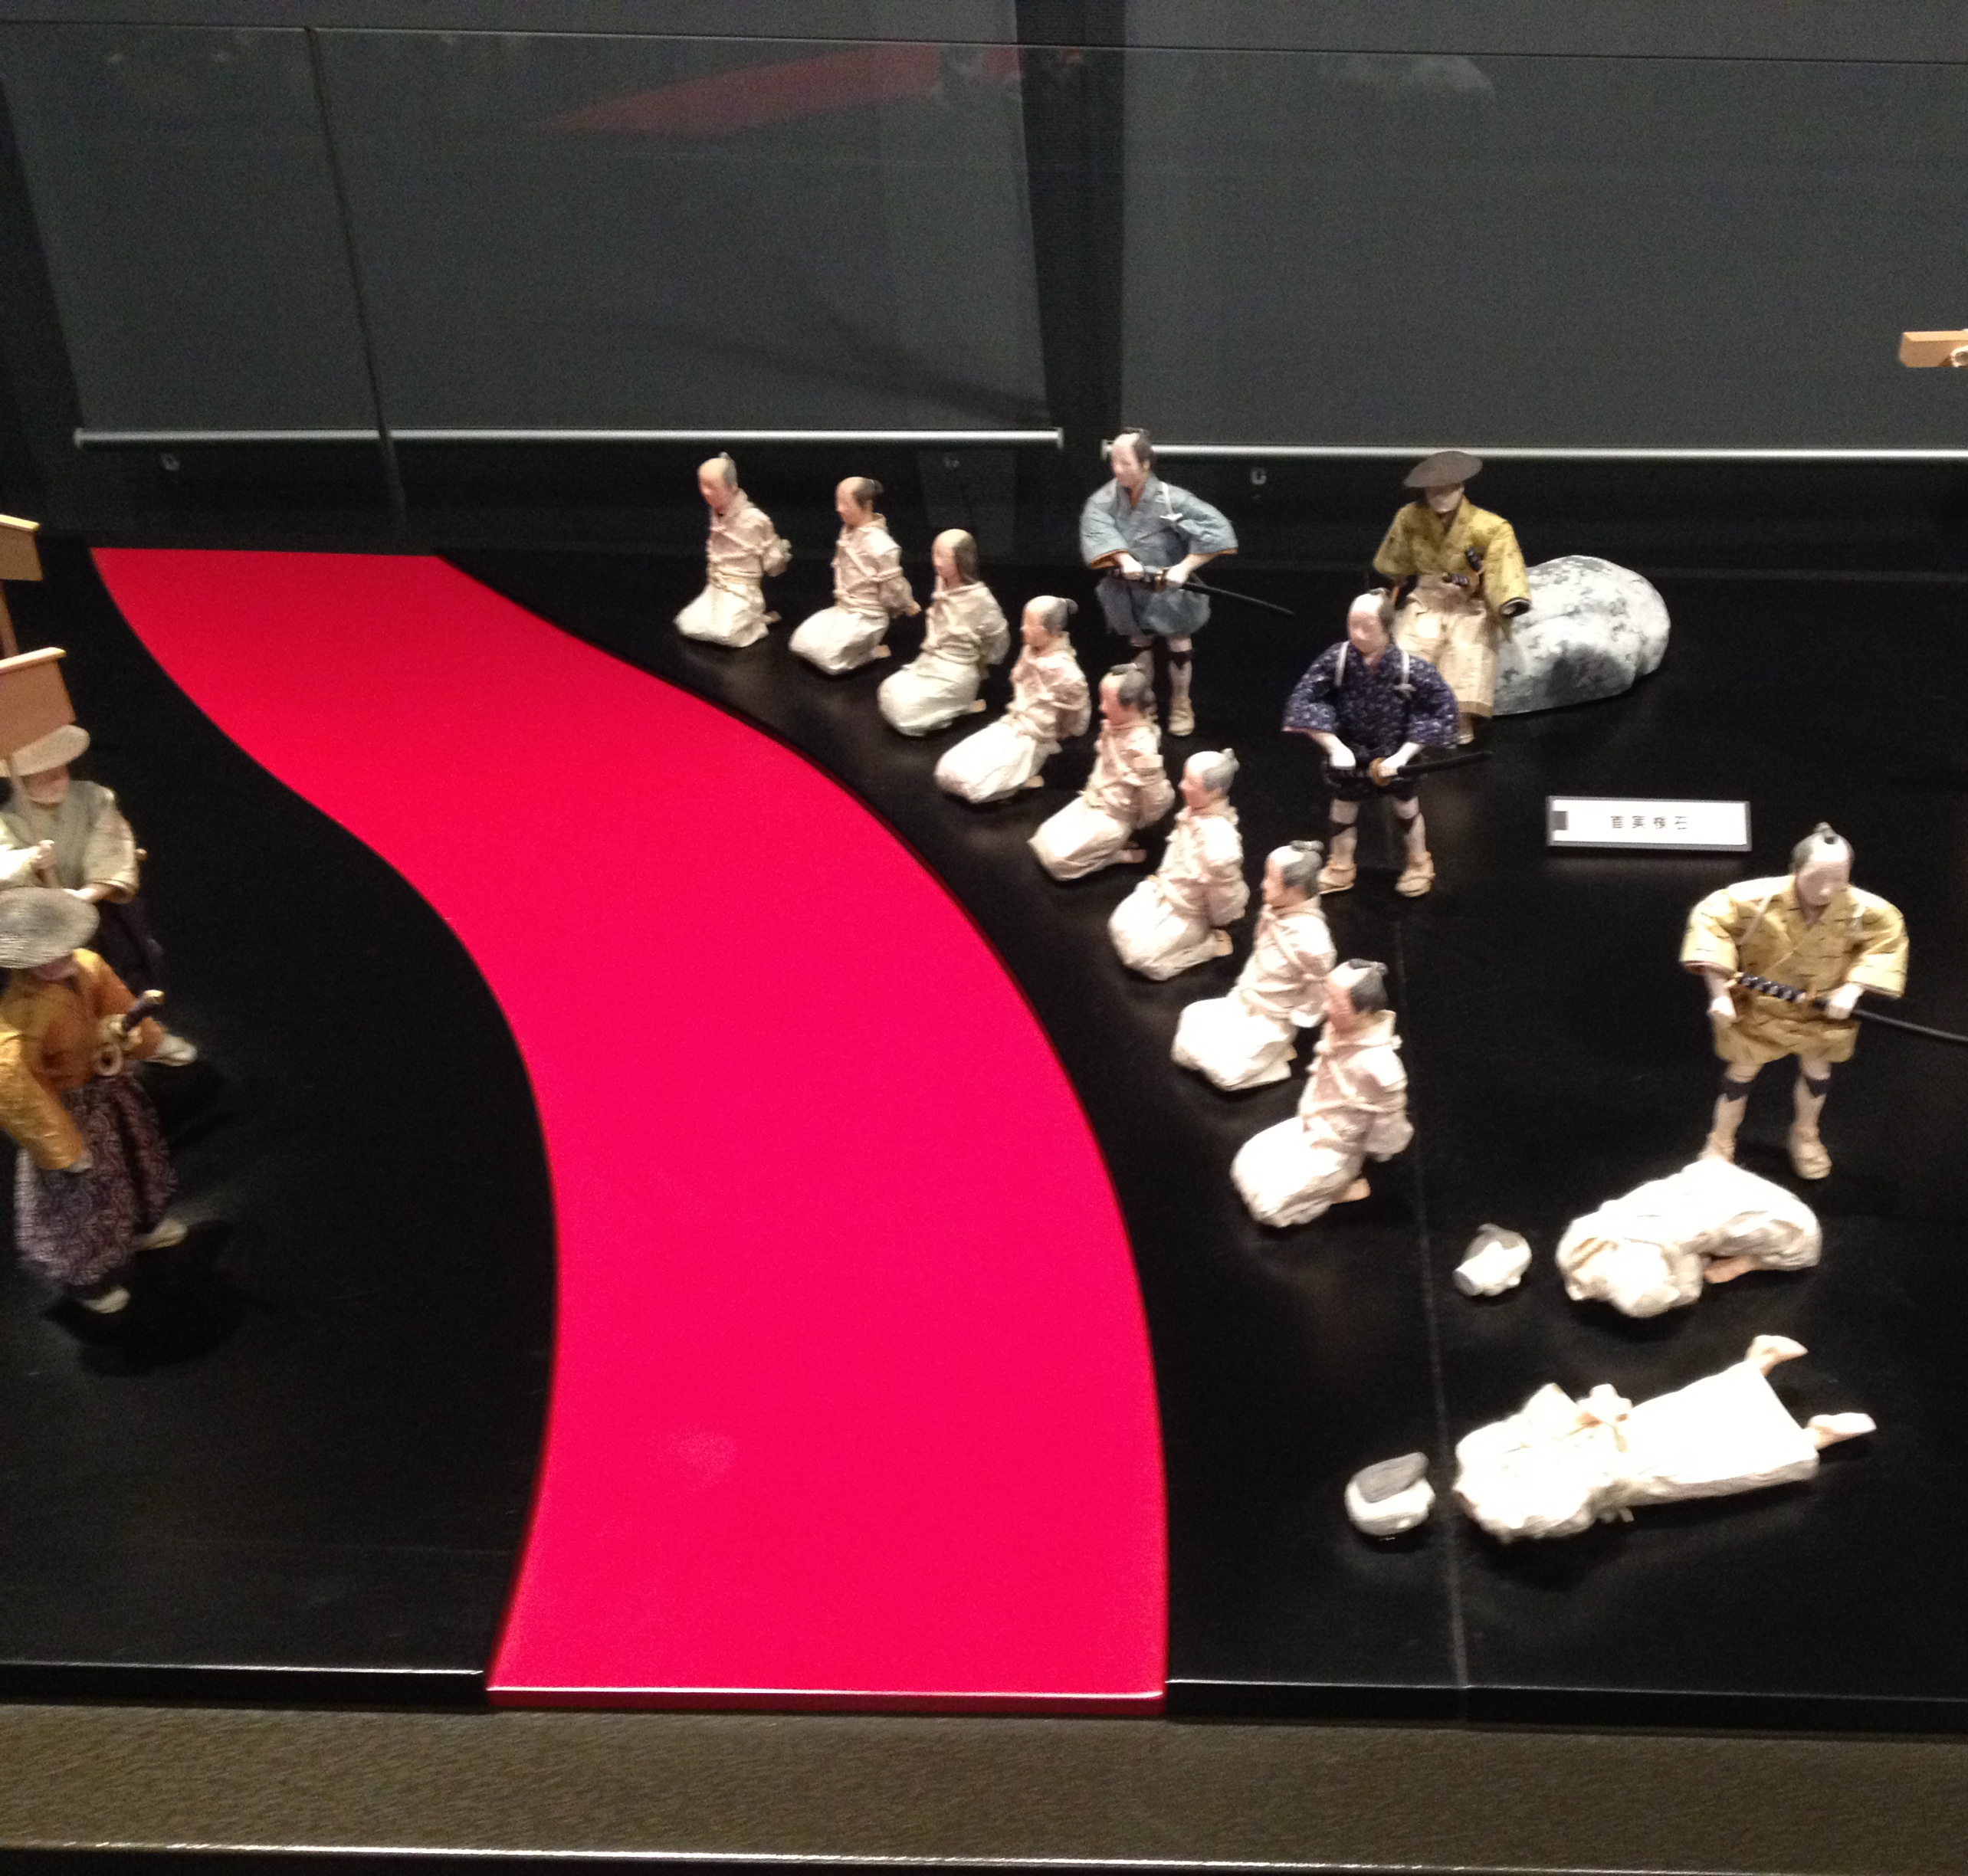
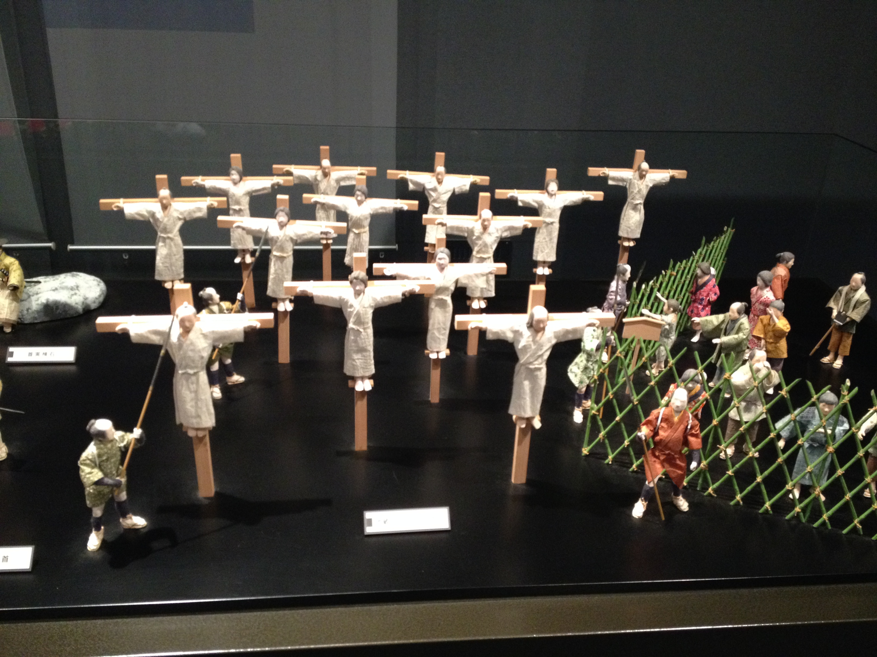

Slide 32
徳川秀忠 Tokugawa Hidetada (1579 – 1632)

Slide 33
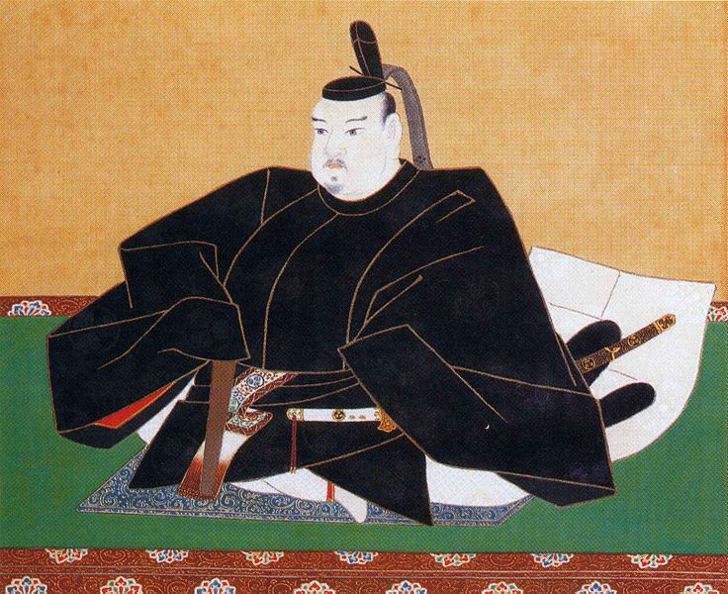
徳川家光 Iemitsu Tokugawa (1604-1651)
Grandson of Ieyasu Tokugawa
Deified his grandfather
Built the Toshogu Shrine in Nikko”
Killed thousands of Christians including the last missionary in Japan

Slide 34
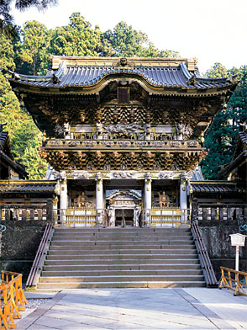
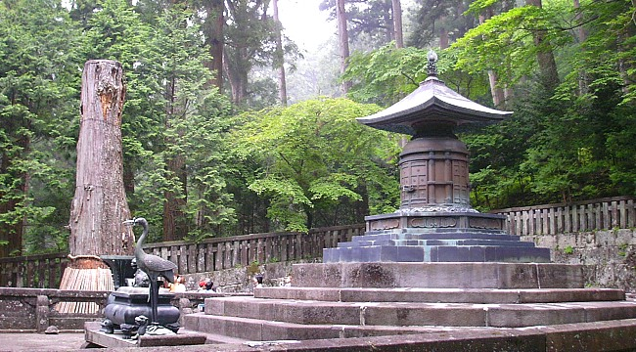
東照宮Toshogu Shrine (Ieyasu)

Slide 35
Iemitsu Tokugawa (1604-1651)
Ordered everyone to register at the Buddhist Temple
Established the Office of Religious Inspection
People were forced to have funerals at Buddhist Temples.

Slide 36
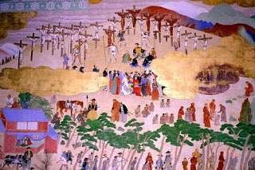
徳川将軍Tokugawa Shoguns
In 1612 there were 300K Christians
In 1625 50% less
In 1644 the last missionary, Konishi Mancio was killed

Slide 37
Forms of torture 拷問の形態

Slide 38
The Pit穴つり

Slide 39
雲仙の地獄責めUnzen Hell 島原Shimabara, Japan

Slide 40
Unzen Hell

Slide 43
Notable Sites and Accounts 名所と記述

Slide 44
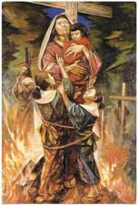
最初の妊婦の殉教 1st Pregnant Mother Martyred
橋本テクラ
Tecla Hashimoto is the only known pregnant martyr in Catholic history.
She was martyred in Kyoto, Japan, on October 6, 1619.

Slide 45
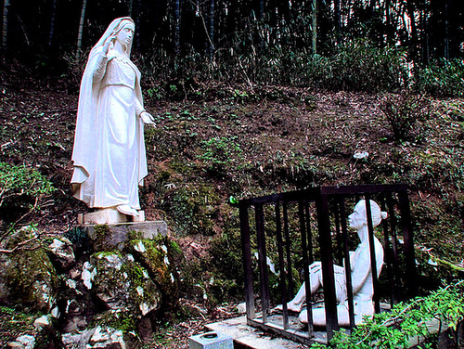
津和野の迫害 Tsuwano Persecution

Slide 46
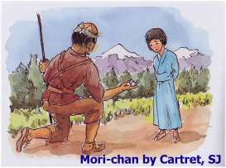
もりちゃん Mori Chan 津和野 Tsuwano, Japan

Slide 47
宮城 仙台Miyagi, Sendai

Slide 48
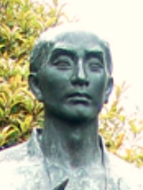
ジョアン原 主水John Hara Mondo
Elite bodyguard of Ieyasu Tokugawa
Arrested in 1623 by the grandson Iemitsu

Slide 49
John Hara Mondo
The tendons of Mondo's hands and feet had been severed and he could not walk nor even stay balanced on a horse.
His nose had been cut off and a cross branded on his forehead.

Slide 50
札の辻 Fuda no Tsuji 50 Executed処刑

Slide 51
Fuda No Tsuji

Slide 52
Fuda no Tsuji

Slide 53
隠れキリシタンKakure Kristian
After the edict banning Christianity from Japan the Christians had to secretly practice their faith and became known as the Kakure Kristian (Hidden Christians)
For nearly 200 years these Christians practiced their faith in secret despite having no Bible, priests, or sacraments except for Baptism.

Slide 54
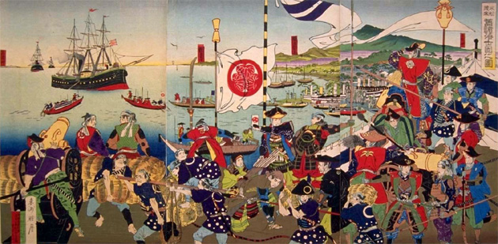
Japan closed its doors to the world in 1639 but in 1853 it reopened its doors to the West with the arrival of Commodore Perry and the “Black Ships.”

Slide 55
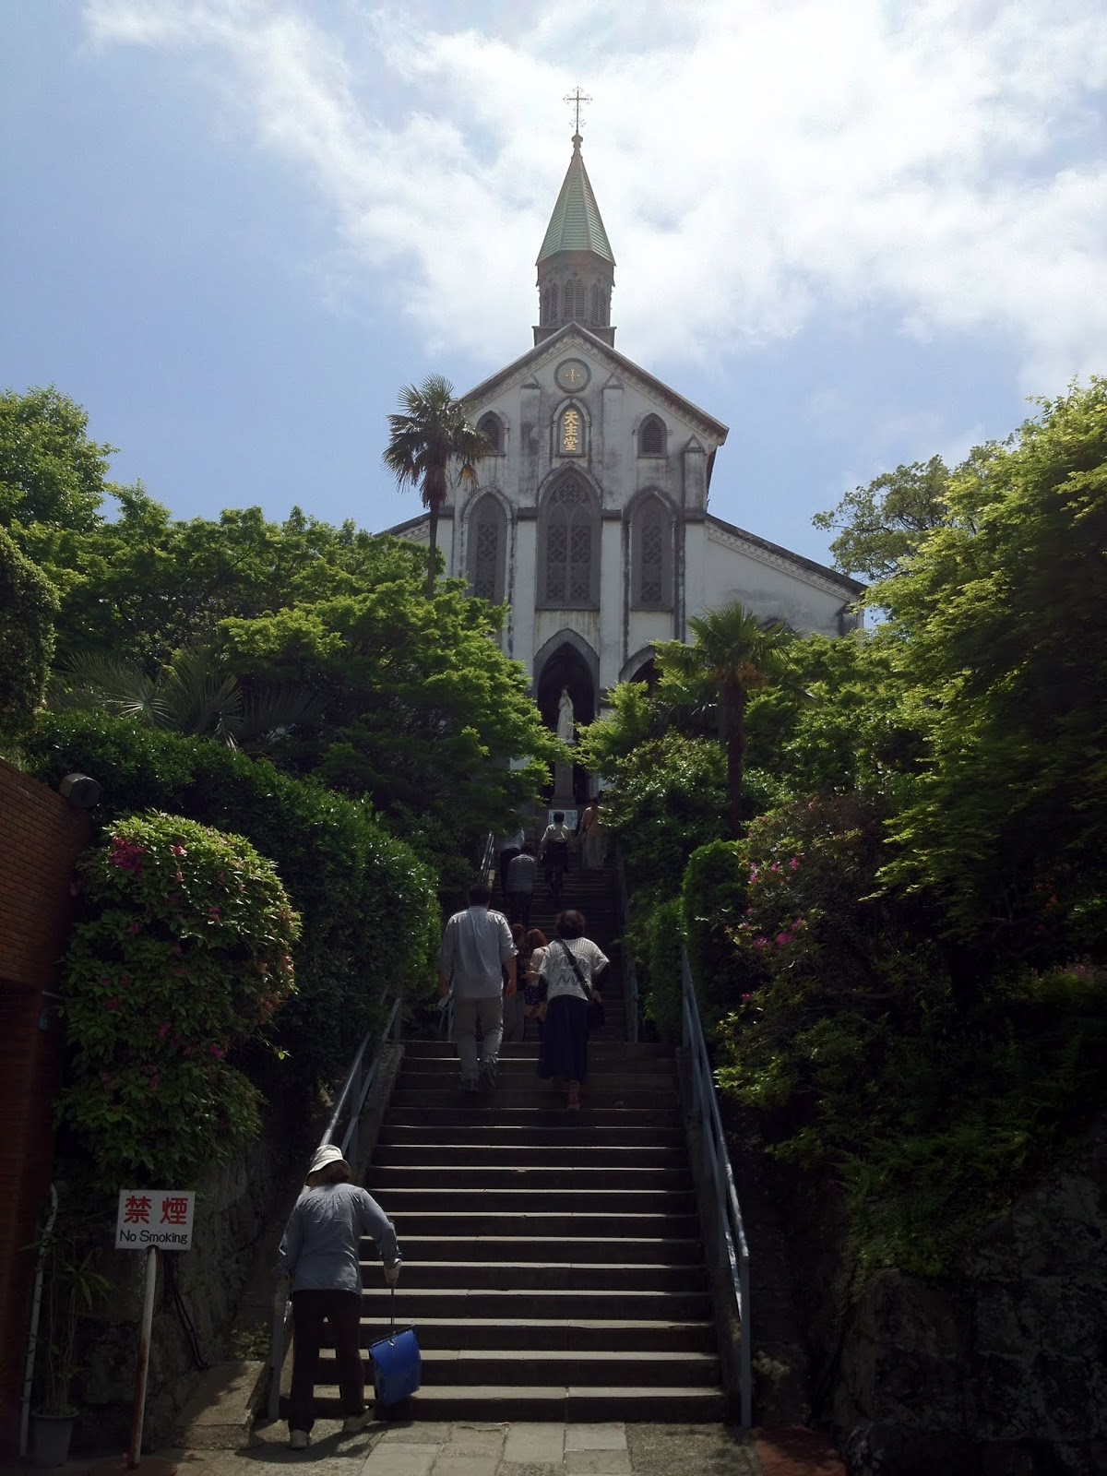
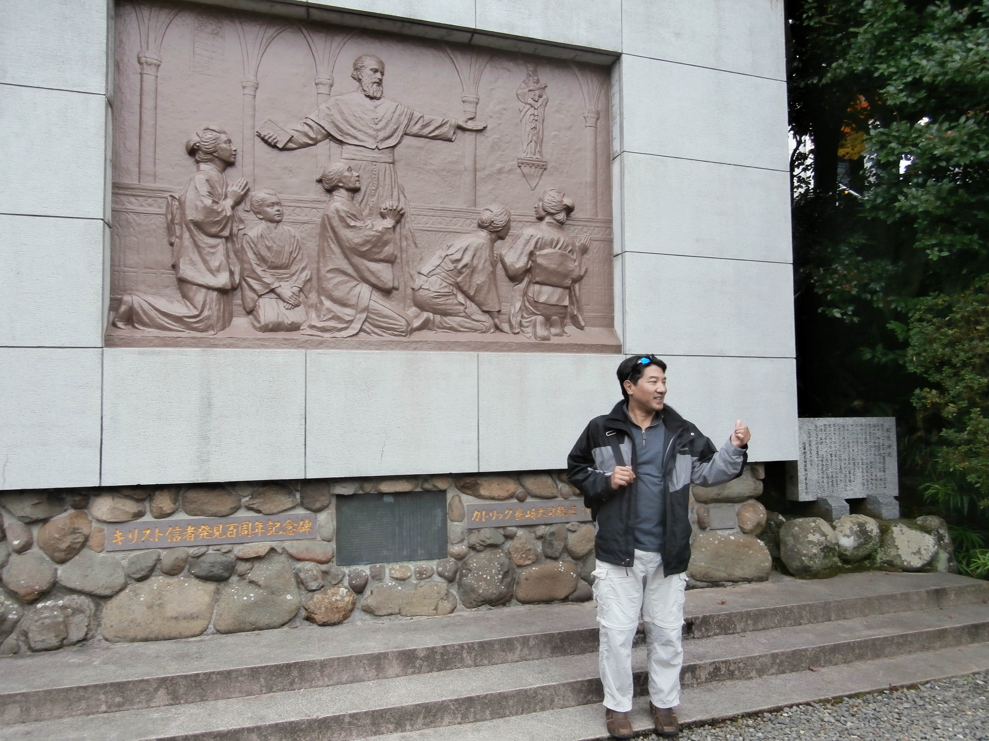
Kakure Kristian
On March of 1865 a small group of villagers in Nagasaki approached French priest Bernard Petitjean at Oura Cathedral and quietly told him, “Our hearts are one with yours.”

Slide 56
日本人殉教者から学ぶこと Life Lessons from the Japan Martyrs
The Japan Martyrs remind us that persecution is part of the Christian life – ヨハネ15:20--21
The Japan Martyrs taught us the meaning of discipleship – ルカ14:26-32
Japan martyrs remind us we are citizens of a heavenly kingdom –ピリピ3:20
Japan Martyrs should inspire us to finish the race – ヘブル12:1-3

Slide 57
義のために迫害されている者は幸いです。天の御国はその人のものだからです。
マタイの福音書5:10
Matthew 5:10.

